Slide 1
SDG’s in the Water Utility Strategy
Torsdag den 26. september 2019 John Buur Christiansen, CEO
Notes:
Have you enjoyed the conference ??
Asset Management - we do not even have a proper word for it in Danish. The ISO translates it to ”Styring af aktiver” which can give you the assosiation of ”driving the asset” - so we call it asset management

Slide 2
Topics
SDG’s – do we really know the structure?
Three different ways to integrate SDG’s in the Water Utility Strategy
An example of how to integrate SDG’s and strategy

Slide 3
Level 1 (Goals) – Common Knowledge, I think

Slide 4
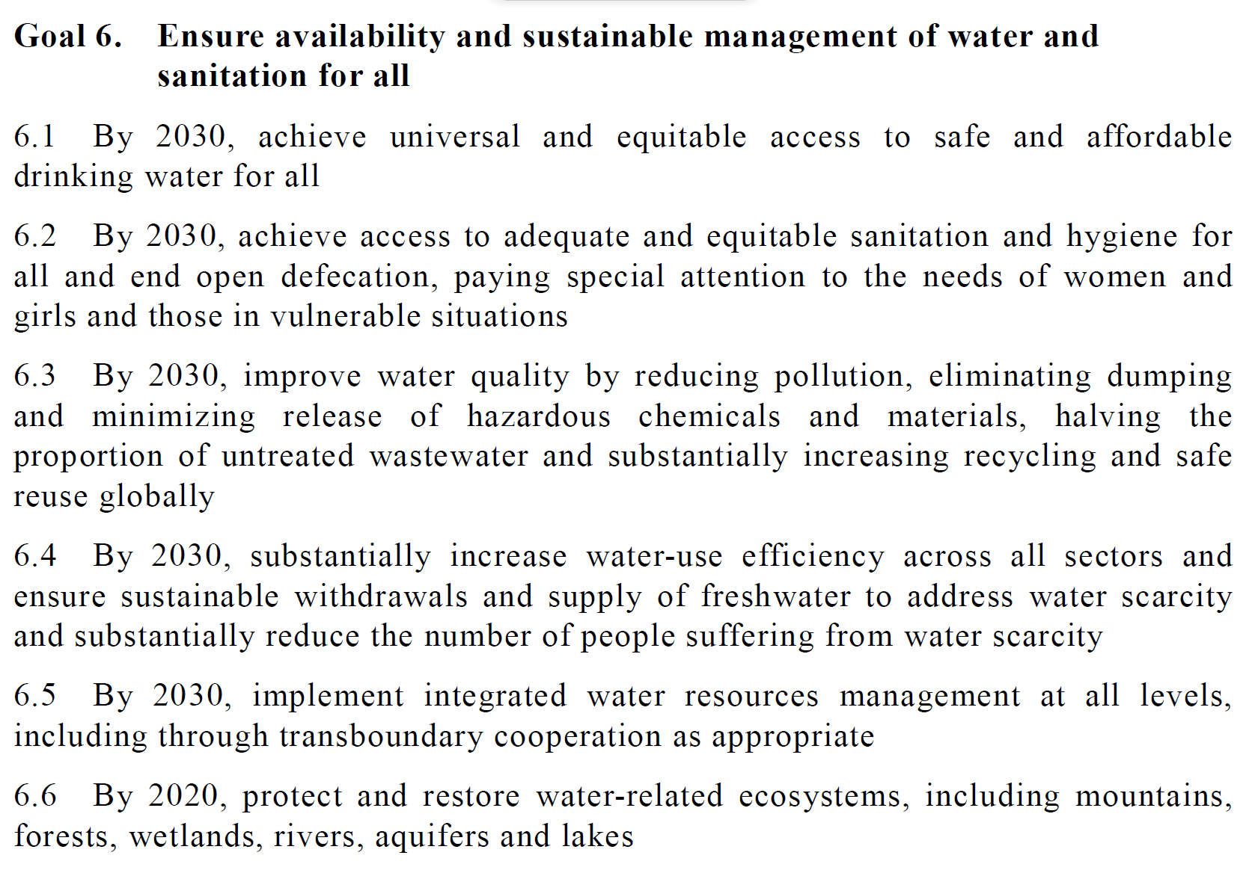
Level 2 (Targets) – Not that Common to All…..
United Nations, General Assembly, Resolution adopted on 25 September 2015, A/RES/70/1, Transforming our world, the 2030 Agenda for Sustainable Development

Slide 5
Level 3 (Global indicators) – only known to a few?
Goal 6. Ensure availability and sustainable management of water and sanitation for all
6.1 By 2030, achieve universal and equitable access to safe and affordable drinking water for all | 6.1.1 Proportion of population using safely managed drinking water services
6.2 By 2030, achieve access to adequate and equitable sanitation and hygiene for all and end open defecation, paying special attention to the needs of women and girls and those in vulnerable situations | 6.2.1 Proportion of population using (a) safely managed sanitation services and (b) a hand-washing facility with soap and water
6.3 By 2030, improve water quality by reducing pollution, eliminating dumping and minimizing release of hazardous chemicals and materials, halving the proportion of untreated wastewater and substantially increasing recycling and safe reuse globally | 6.3.1 Proportion of wastewater safely treated
 | 6.3.2 Proportion of bodies of water with good ambient water quality
Which indicators to choose as a Water Utility?
The Answer is in your Strategy!

Slide 6
First option: ”Focusing” on a single SDG!

Slide 7
Second option: “Integrate” a few SDG’s in your Strategy

Slide 8
Third option: “Compliance” – Follow all SDG or explain why not

Slide 9
“If you can't measure it,
you can't improve it.”
Peter Drucker

Slide 10
How to integrate SDG’s in the Water Utility Strategy?
Mission
Vision
Targets/KPI’s
Area of strategy
Objectives
Level 2-targets
(Level 3- indicators)
How you work with SDG’s - option 1, 2 or 3?
Level 1-goals
Water Utility Strategy
SDG’s

Slide 11
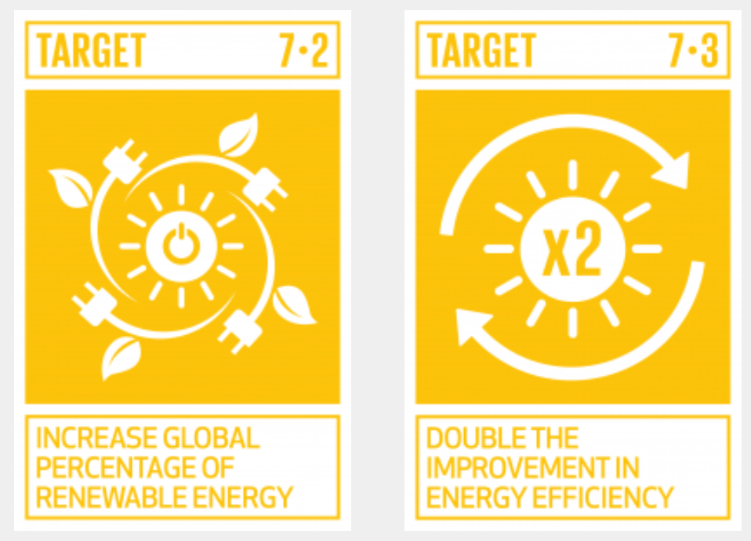
Clear Line of Sight – integrated with SDG’s
Area of Strategy
Ressources and Production
” We will increase security of supply and the efficiency of our Assets”
Objective
We sell more energy than we buy
Target/KPI
Sell 240 % more energy from WWTP Lynetten than we buy
Indicator 7.2.1: Renewable energy share in the total final energy consumption

Slide 12
Some findings on SDG’s and Water Utility Strategy
First, understand the nature and structure of the SDG’s
Secondly, map the SDG’s together with your current strategy
Thirdly, choose how you want to work with SDG’s – see my three different options
Finally, make a clear line of sight in your (new?) Strategy, and integrate the elements of the SDG’s directly in the different elements of the Strategy

Slide 13
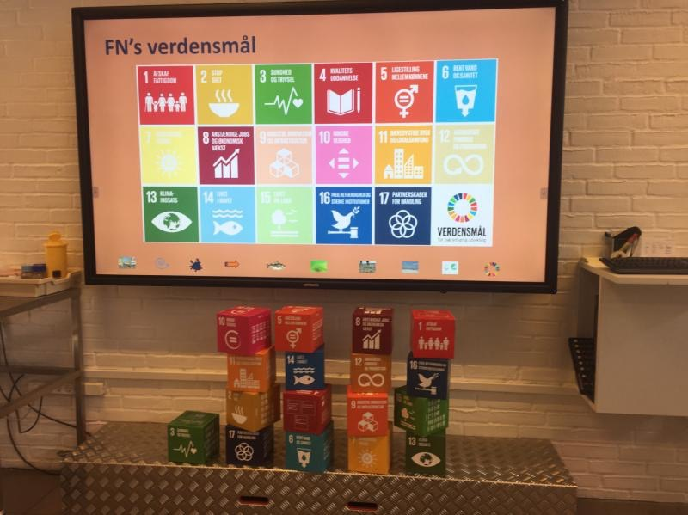
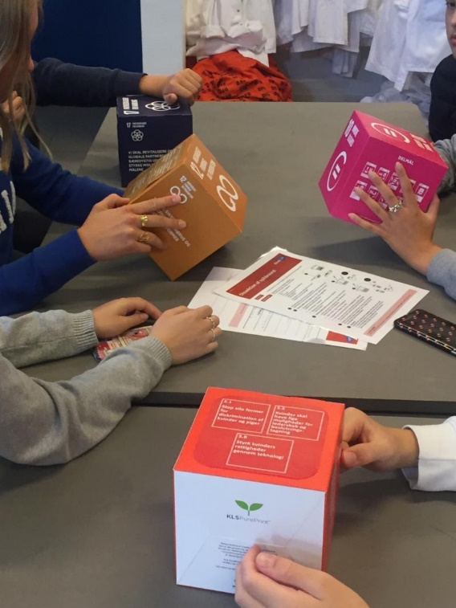
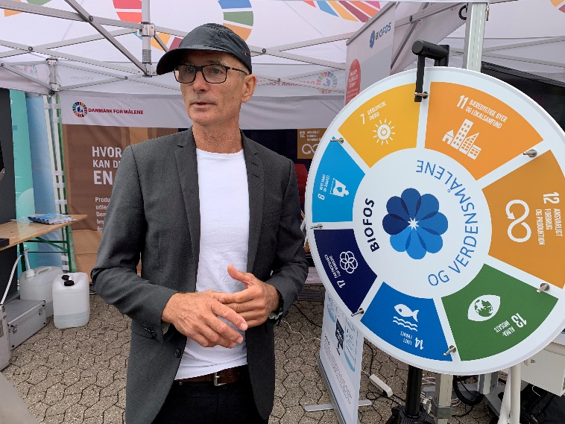
BIOFOS
Head office: BIOFOS Refshalevej 250 DK-1432 Copenhagen K post@biofos.dk Tel.: +45 32 57 32 32
www.biofos.dk
Find us on linkedin: http://linkedin/company/biofos

